Slide 1

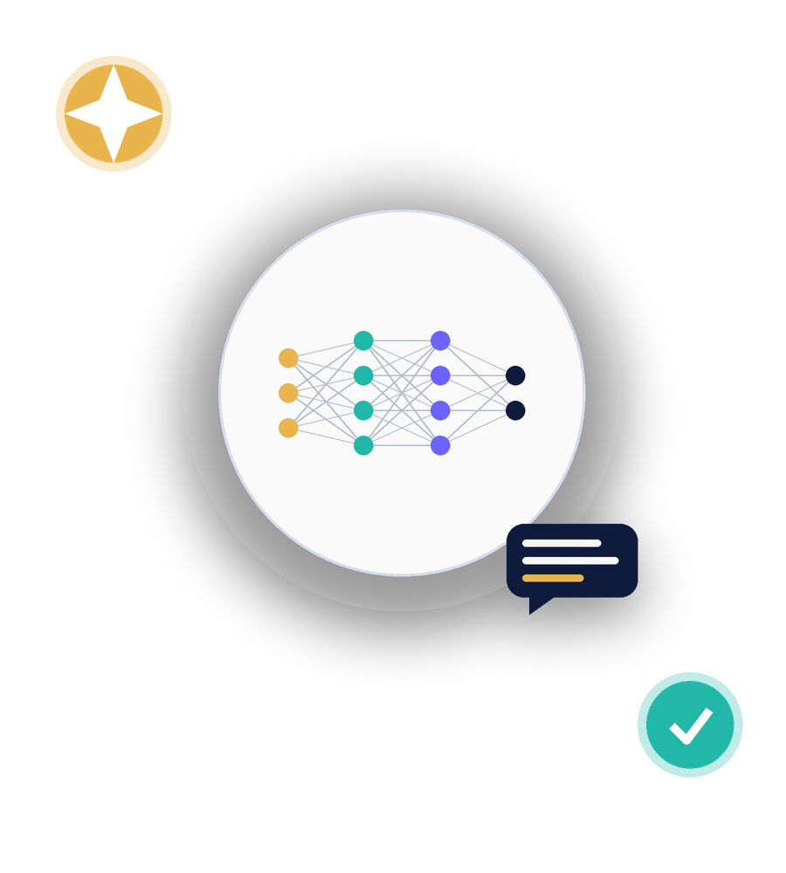
SESSION 0
Introduction to Artificial Intelligence & Generative AI
Two-Day Student Workshop
AI, LLMs, tokens & prompting, practical prompting, and responsible AI use
Rohan Sudhan | Rida Arshad

Slide 2









AGENDA
What We'll Cover Today
1 Introduction to AI
2 Generative AI & LLMs
Everyday life, engineering, and how AI relates to ML, DL and GenAI
What large language models are and how they're trained
3 How LLMs Process Text
4 Understanding AI Prompts
Tokens, context windows and next-token prediction
The structure of a good prompt
5 Practical Prompting
6 Capabilities & Limitations
Turning a weak prompt into a strong one
Hallucinations, bias and why you verify
7 Responsible & Ethical Use
8 Activity & Recap
Academic integrity and privacy
You improve a prompt and we wrap up
Introduction to AI & Generative AI | Session 0
2

Slide 3



1 | INTRODUCTION TO AI
AI Is Already Around You
Everyday life
ASK THE ROOM
Voice assistants, recommendation feeds, spam filters, maps and navigation
What is one AI tool you already use every day, without thinking of it as AI?
Engineering
Predictive maintenance, autonomous systems, generative design, quality inspection
• Autocorrect and predictive text
• Photo tagging and face grouping
Why it matters now
• Streaming service recommendations
AI tools are becoming part of how engineers research, build and write
• Maps traffic prediction
Introduction to AI & Generative AI | Session 0
3
Notes:
AI isn't something futuristic.
Examples from everyday life:
Voice assistants
Recommendations
Spam filters
Maps/navigation
Autocorrect
Face/photo grouping
AI in engineering:
Predictive maintenance
Autonomous systems
Generative design
Quality inspection

Slide 4
1 | INTRODUCTION TO AI
AI, ML, Deep Learning & Generative AI
Artificial Intelligence
Machines that mimic human tasks
Machine Learning
Systems that learn patterns from data
Deep Learning
Learning using layered neural networks
Generative AI
Creates new text, images, code and more
Introduction to AI & Generative AI | Session 0
4
Notes:
Artificial Intelligence
Machines performing tasks that normally require human-like intelligence.
Machine Learning
A subset of AI where systems learn patterns from data.
Deep Learning
A subset of ML using layered neural networks.
Generative AI
AI systems that generate new content:
Text
Images
Code
etc.

Slide 5






2 | GENERATIVE AI & LLMS
What Generative AI Can Create
Text
Images
Audio
Essays, code, summaries, conversations
Illustrations, designs, edited photos
Speech, music, voice cloning
Video
Code
3D & Data
Short clips, animations, avatars
Functions, scripts, whole applications
Models, synthetic datasets, simulations
LLM = Large Language Model a Generative AI model trained on massive amounts of text to understand and produce language
Introduction to AI & Generative AI | Session 0
5
Notes:
Large Language Model
A GenAI model trained on huge amounts of text to understand and generate language.
Generative AI = broad category
LLMs = language-focused models within GenAI

Slide 6
2 | GENERATIVE AI & LLMS
Training vs. Inference
Training
Inference
Happens once, before you ever use the tool
Happens every time you send a prompt
Model reads huge amounts of text
You type a prompt
Learns patterns, grammar, facts and style
The trained model predicts a response
Adjusts billions of internal parameters
Happens in seconds on existing knowledge
Takes weeks and massive computing power
The model does not learn from this chat
Introduction to AI & Generative AI | Session 0
6
Notes:
TRAINING
Happens before you use the model.
Know:
Huge amounts of text/data
Model learns patterns
Grammar
Facts/information
Styles/patterns
Internal parameters are adjusted
Requires enormous computing resources
Takes significant time
INFERENCE
Happens when you actually send a prompt.
Flow:
You type prompt → model processes it → generates response
Important distinction:
Training ≠ chatting with the model.

Slide 7


3 | HOW LLMS PROCESS TEXT
Tokens & the Context Window
A TOKEN IS A CHUNK OF TEXT
NEXT-TOKEN PREDICTION
Under
stand
ing
AI
prompt
ing
The model generates a reply one token at a time, each time predicting the single most likely next token given everything written so far.
“Understanding AI prompting” breaks into 6 tokens
Context window
The amount of text the model can “see” at once: your prompt, the conversation so far, and its reply
Once a chat gets too long, the earliest messages fall out of the context window - the model simply can't “see” them anymore.
Parameters
Internal values tuned during training; more parameters generally means more capability
Introduction to AI & Generative AI | Session 0
7
Notes:
Token
A token is a chunk of text.
It might be:
A whole word
Part of a word
Punctuation
Other text pieces
Context Window
Think:
How much information the model can see at one time.
It includes:
Your current prompt
Previous conversation/context
The response being generated

Slide 8






4 | UNDERSTANDING AI PROMPTS
Anatomy of a Good Prompt
Task
Context
Role
What exactly do you want done?
Background the model needs
Who should the AI act as?
“Summarize this research paper”
“It's for a first-year engineering audience”
“Act as a patient writing tutor”
Constraints
Output format
Iteration
Limits on length, tone, scope
How should the answer look?
Refine based on the result
“Keep it under 150 words, no jargon”
“Return 5 bullet points”
“Make the third point more specific”
Introduction to AI & Generative AI | Session 0
8

Slide 9


5 | PRACTICAL PROMPTING
Basic vs. Detailed Prompts
BASIC PROMPT
DETAILED PROMPT
“Explain machine learning”
“Explain machine learning to a first-year engineering student in 4 bullet points, using a real-world analogy”
Result: a generic, unfocused answer that may be too basic or too advanced, in no particular format.
Result: a focused, appropriately-pitched answer in the exact format you need.
Introduction to AI & Generative AI | Session 0
9
Notes:
Basic:
Explain machine learning.
Problem:
No audience
No desired length
No format
No level
No context
Detailed:
Explain machine learning to a first-year engineering student in 4 bullet points, using a real-world analogy.
Now AI knows:
Topic
Audience
Format
Amount
Style/approach

Slide 10




5 | PRACTICAL PROMPTING
Prompting Is a Conversation, Not One Shot
Ask
Evaluate
Refine
Repeat
Start with your best first attempt at the prompt
Read the response critically - what's missing or wrong?
Ask for changes: shorter, simpler, more examples, different tone
Keep iterating until the response actually works for you
Even experts rarely get the perfect prompt on the first try - refining is the normal workflow.
Introduction to AI & Generative AI | Session 0
10

Slide 11




6 | CAPABILITIES & LIMITATIONS
AI Sounds Confident. It Isn't Always Right.
Hallucinations
Outdated information
AI can generate plausible-sounding facts, quotes or sources that are simply made up
The model's knowledge has a cutoff date and may not reflect recent events
Fabricated citations
Bias & reliability
Paper titles, authors and DOIs can look completely real and still not exist
Training data can carry hidden biases that shape AI responses
Introduction to AI & Generative AI | Session 0
11
Notes:
Hallucinations
AI can produce:
Fake facts
Fake quotes
Fake information
while sounding completely confident.
Outdated information
AI may not know about recent developments depending on the model/tool.
Fabricated citations
AI can generate:
Fake paper titles
Fake authors
Fake DOIs
Fake references
Bias
Training data can contain biases, which can affect outputs.
Confident ≠ Correct.

Slide 12




6 | CAPABILITIES & LIMITATIONS
Why Human Verification Matters
Check facts, quotes and figures at the original source
Confirm citations and links actually exist
You are the verifier
AI is a fast first draft, not a final authority. The responsibility for accuracy stays with you.
Never submit content you can't explain yourself
Test and run any AI-generated code before trusting it
Introduction to AI & Generative AI | Session 0
12
Notes:
Check facts
Check original sources
Verify quotations
Verify numbers
Check whether citations actually exist
Test AI-generated code
Understand anything they submit
Especially:
Never submit something you can't explain yourself.

Slide 13




7 | RESPONSIBLE & ETHICAL USE
Using AI the Right Way
Academic integrity
Privacy & sensitive info
Follow your institution's rules on AI use in assignments and exams
Never paste personal, confidential or private data into AI tools
Verification
Appropriate academic use
Always verify AI-generated content before you rely on or submit it
Use AI to learn and improve, not to bypass the learning itself
Introduction to AI & Generative AI | Session 0
13
Notes:
1. Academic integrity
Follow your institution's rules regarding AI.
2. Privacy
Don't paste:
Personal information
Confidential information
Private data
into AI tools unnecessarily.
3. Verification
Check AI output before relying on it.
4. Appropriate academic use
AI should help you:
Learn → understand → improve

Slide 14
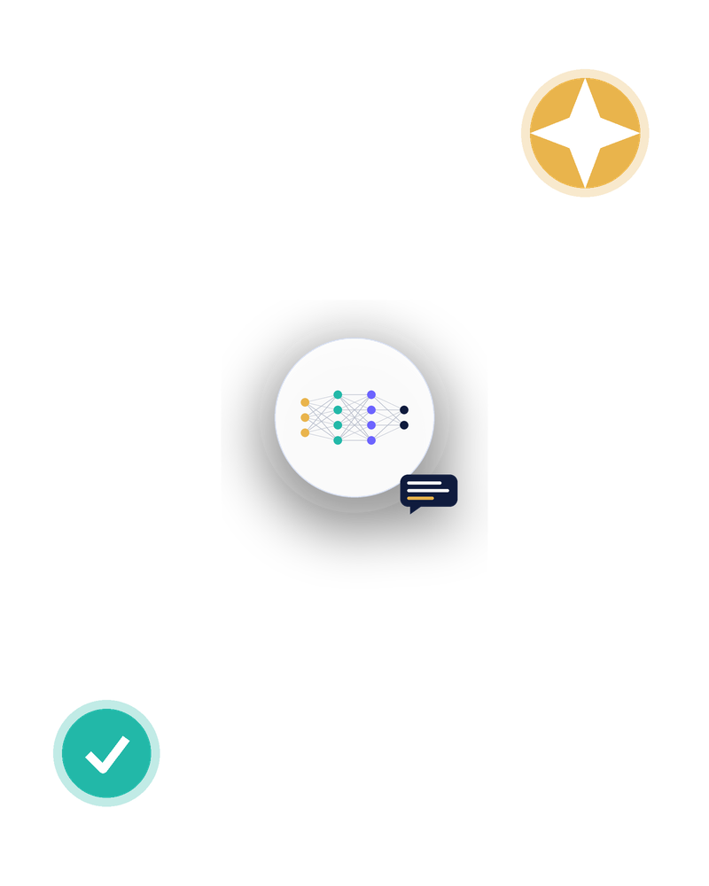
INTERACTIVE ACTIVITY
Fix the Prompt
STARTING PROMPT
“Write about renewable energy”
1 Add context, a role or constraints
2 Specify the output format you want
3 Run it and compare with a partner
4 Refine once more based on the result

Slide 15




RECAP
Key Takeaways
AI contains ML, DL and Generative AI
Each is a narrower category inside the one before it
LLMs predict text one token at a time
Using patterns learned during training, within a context window
Good prompts give context and format
Task, context, role, constraints and output format all help
AI can be confidently wrong
Hallucinations and fabricated citations are real risks
You are responsible for verification
Check facts, respect privacy, and follow academic integrity rules
Introduction to AI & Generative AI | Session 0
15

Slide 16
Thank You
Questions and discussion
Next up: putting this into practice with research and resumes.
RS
Rohan Sudhan
3BR23CD002
RA
Rida Arshad
3BR23CD076
Notes:
Open the floor for questions. Remind students this session sets up the tools they'll use hands-on in the next two sessions.

